Slide 1
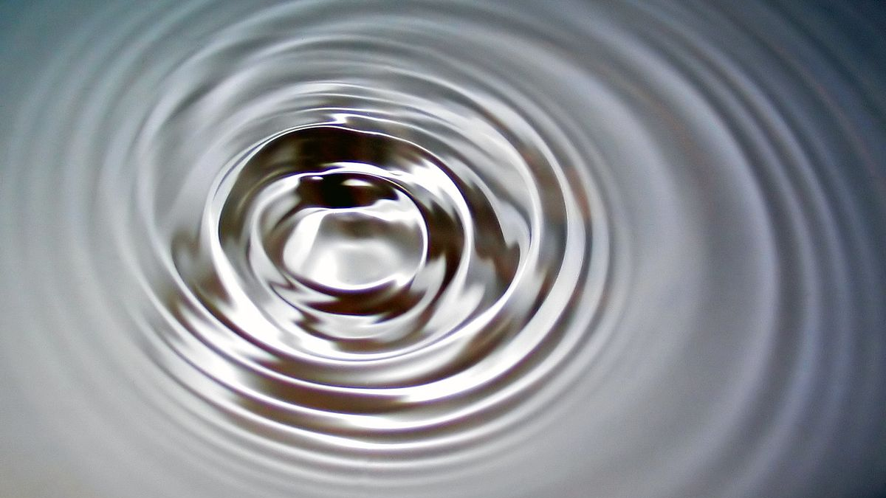
Oscillations and Waves (Part 4)
Damped Oscillations and Forced Oscillations
Dr. Sourav Marik
Assistant Professor, TIET, Patiala

Slide 2

Damped harmonic motion
Damped harmonic motion is harmonic motion with a frictional or drag force. Consequently, the mechanical energy of the system diminishes in time, and the motion is said to be damped.

Slide 3





Damped harmonic motion
Damped harmonic motion is harmonic motion with a frictional or drag force. Consequently, the mechanical energy of the system diminishes in time, and the motion is said to be damped.
$$x$$
$$t$$
$$t$$

Slide 4
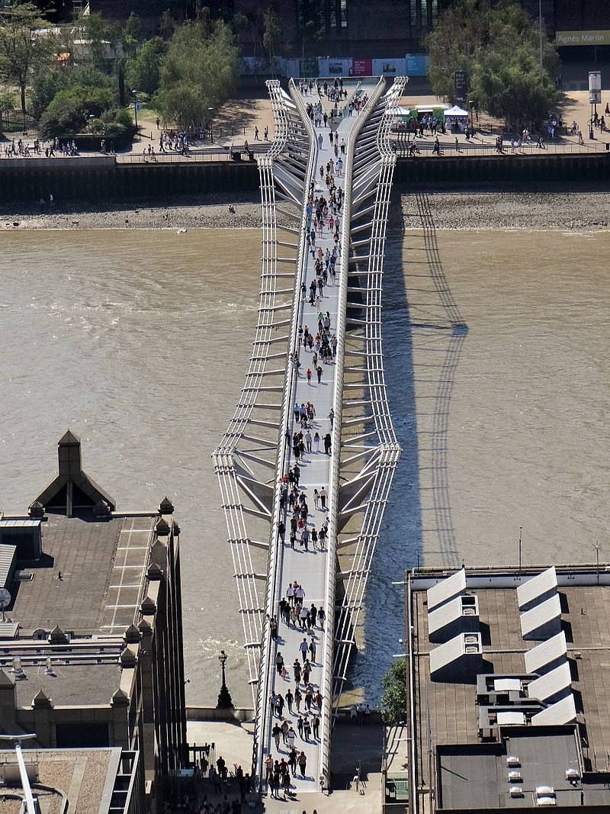
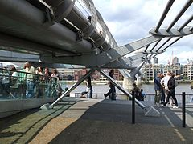
Damped harmonic motion
Damped harmonic motion is harmonic motion with a frictional or drag force. Consequently, the mechanical energy of the system diminishes in time, and the motion is said to be damped.
Vertical to ground dampers
Millennium Bridge, London
Damping was installed on London’s Millennium Bridge shortly
after it opened
Wikipedia

Slide 5
Damped harmonic motion
If the damping is large, it no longer resembles SHM
Underdamping: There are a few small oscillations before the oscillator comes to rest.
Critical damping: this is the fastest way to get to equilibrium.
Overdamping: the system is slowed so much that it takes a long time to get to equilibrium.

Slide 6


Damped harmonic motion
If the damping is large, it no longer resembles SHM
Underdamping: There are a few small oscillations before the oscillator comes to rest.
Critical damping: this is the fastest way to get to equilibrium.
Overdamping: the system is slowed so much that it takes a long time to get to equilibrium.
$$x$$
III
$$t$$
II
$$t$$
I

Slide 7


Damped harmonic motion
If the damping is large, it no longer resembles SHM
Underdamping: There are a few small oscillations before the oscillator comes to rest.
Critical damping: this is the fastest way to get to equilibrium.
Overdamping: the system is slowed so much that it takes a long time to get to equilibrium.
$$x$$
Systems where damping is wanted/unwanted
III
$$t$$
Automobile, shock absorbers
II
$$t$$
I
Clocks and watches

Slide 8

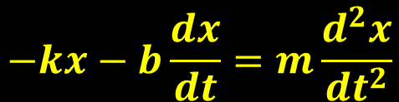
Damped harmonic motion
The retarding force/damping force is often observed when an object moves through a viscous fluid.
Retarding force : R = -bv (where b is a damping coefficient)
Restoring force : F = -kx (where k is a spring constant)
Using Newton’s second law as ;
$$ΣF_{x}=−kx−bv_{x}=ma_{x}$$
$$−kx−b\frac{ⅆx}{ⅆt}=m\frac{ⅆ^{2}x}{ⅆt^{2}}$$

Slide 9
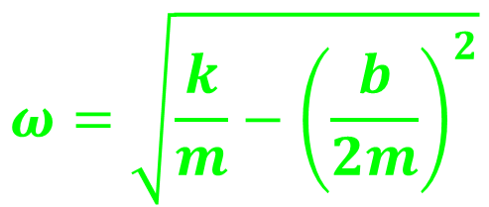
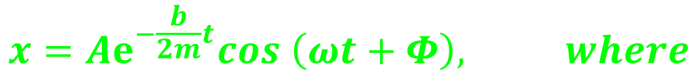
Damped harmonic motion
The retarding force/damping force is often observed when an object moves through a viscous fluid.
Retarding force : R = -bv (where b is a damping coefficient)
Restoring force : F = -kx (where k is a spring constant)
Using Newton’s second law as ;
$$ΣF_{x}=−kx−bv_{x}=ma_{x}$$
$$−kx−b\frac{ⅆx}{ⅆt}=m\frac{ⅆ^{2}x}{ⅆt^{2}}$$
When the retarding force is small compared with the maximum restoring force that is, when b is small, the solution to above equation is;
$$ω=\sqrt{\frac{k}{m}−{\left(\frac{b}{2m}\right)}^{2}}$$
$$x=Aⅇ^{−\frac{b}{2m}t}cos \left(ωt+Φ\right), where$$

Slide 10

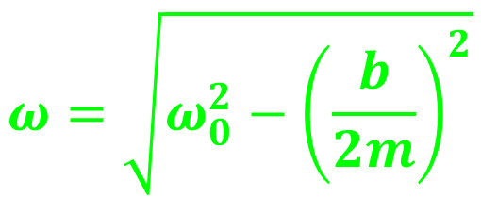




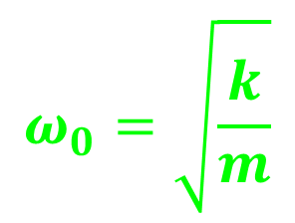
Damped harmonic motion
when the retarding force is small, the oscillatory character of the motion is preserved but the amplitude decreases in time, with the result that the motion ultimately ceases. Any system that behaves in this way is known as a damped oscillator.
$$x$$
$$ω=\sqrt{ω_{0}^{2}−{\left(\frac{b}{2m}\right)}^{2}}$$
$$ω_{0}=\sqrt{\frac{k}{m}}$$
$$A$$
$$Aⅇ^{−\frac{b}{2m}t}$$
$$t$$
$$t$$
$ω_{0}$represents the angular frequency in the absence of a retarding force (the undamped oscillator) and is called the natural frequency of the system
Amplitude decays exponentially with time

Slide 11
Forced Oscillations
Forced vibrations occur when there is a periodic driving force. This force may or may not have the same period as the natural frequency of the system. If the frequency is the same as the natural frequency, the amplitude becomes quite large. This is called resonance.
The sharpness of the resonant peak depends
on the damping. If the damping is small, (A) it can be quite sharp;
If the damping is larger, (B) It is less sharp.
Like damping, resonance can be wanted or unwanted. Musical instruments and TV/radio receivers depend on it.
A
Amplitude
B
External frequency

Slide 12
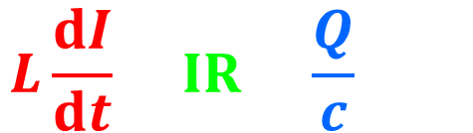
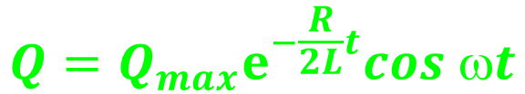



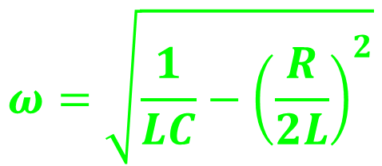

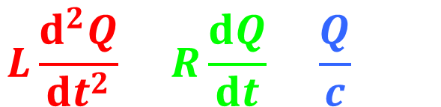

Example: electrical Oscillator- LCR circuit
$$L\frac{ⅆI}{ⅆt}+IR+\frac{Q}{c}=0$$
+Q
L
$$L\frac{ⅆ^{2}Q}{ⅆt^{2}}+R\frac{ⅆQ}{ⅆt}+\frac{Q}{c}=0$$
C
-Q
R
$$m\frac{ⅆ^{2}x}{ⅆt^{2}}+b\frac{ⅆx}{ⅆt}+kx=0$$
Mechanical
$$Q$$
$$Q_{max}$$
$$ⅇ^{−\frac{R}{2L}t}$$
$$Q=Q_{max}ⅇ^{−\frac{R}{2L}t}cos ωt$$
$$t$$
$$t$$
$$ω=\sqrt{\frac{1}{LC}−{\left(\frac{R}{2L}\right)}^{2}}$$

Slide 13








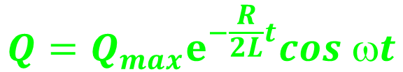


Example: electrical Oscillator- LCR circuit
$$Q$$
$$Q=Q_{max}ⅇ^{−\frac{R}{2L}t}cos ωt$$
$$Q_{max}$$
damping
$$ω=\sqrt{\frac{1}{LC}−{\left(\frac{R}{2L}\right)}^{2}}$$
$$t$$
$$t$$
There exists a critical resistance value above which no oscillations occur.
A system with R = $R_{C}$ is said to be critically damped.
When R exceeds $R_{C}$, the system is said to be overdamped.
$$Q$$
Over damping
$$R_{C}=\sqrt{\frac{4L}{C}}$$
$$Q_{max}$$
$$R_{C}>\sqrt{\frac{4L}{C}}$$
$$t$$

Slide 14
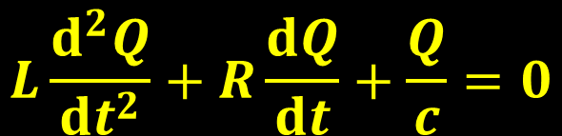
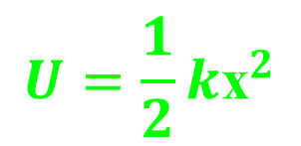

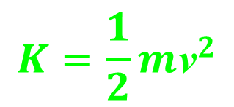
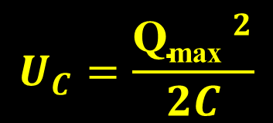
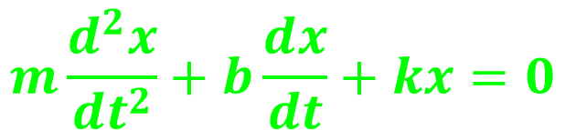
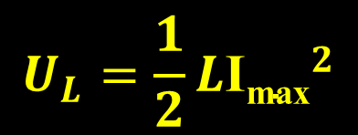

Electrical Oscillator- Mechanical Oscillator
$$L\frac{ⅆ^{2}Q}{ⅆt^{2}}+R\frac{ⅆQ}{ⅆt}+\frac{Q}{c}=0$$
$$m\frac{ⅆ^{2}x}{ⅆt^{2}}+b\frac{ⅆx}{ⅆt}+kx=0$$
C
L
R
$$U_{L}=\frac{1}{2}L{\text{I}\text{max}}^{2}$$
$$K=\frac{1}{2}m{\text{v}}^{2}$$
$$U_{C}=\frac{{\text{Q}\text{max} }^{2}}{2C}$$
$$U=\frac{1}{2}k{\text{x}}^{2}$$

Slide 15
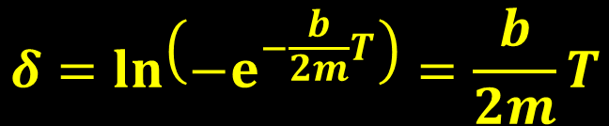
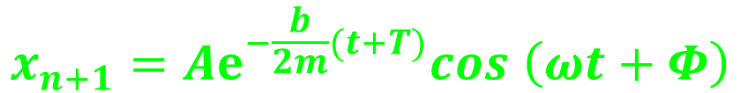
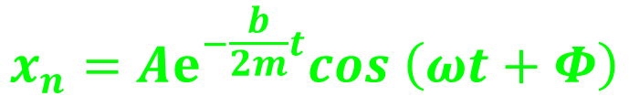
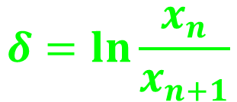

Logarithmic decrement (δ)
Logarithmic decrement measures the rate at which the amplitude of the oscillatory motion decay – A measure of the decrease
$$x$$
Let P₁ & P₂ be the two successive maxima corresponding to amplitudes, say x_{n} and x_{n+1}, and separated by a time period T= 2π/ω. If the maximum P₁ is occurring at t₁ = t, then P₂ will occur at t₂ = t+2π/ω
x_{n}
x_{n+1}
$$t$$
$$t$$
P₁
P₂
$$δ=\ln{\frac{x_{n}}{x_{n+1}}}$$
$$x_{n}=Aⅇ^{−\frac{b}{2m}t}cos \left(ωt+Φ\right)$$
$$x_{n+1}=Aⅇ^{−\frac{b}{2m}(t+T)}cos \left(ωt+Φ\right)$$
$$δ=\ln\left({−ⅇ}^{−\frac{b}{2m}T}\right)=\frac{b}{2m}T$$

Slide 16
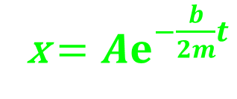
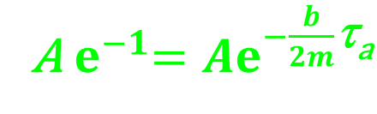
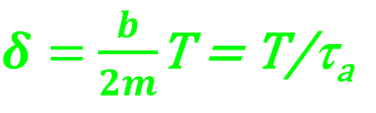

Relaxation time (τ)
The relaxation time is a measures of time (τ_{a}) during which the amplitude of an oscillatory motion decay to 1/e of its initial value.
Or
The time (τ_{a}) during which the energy of an oscillatory motion decays to 1/e of its initial value.
x $=Aⅇ^{−\frac{b}{2m}t}$
By definition, at t = τ_{a} , x = A/e
τ_{a} = $\frac{2m}{b}$
A${ ⅇ}^{−1}=Aⅇ^{−\frac{b}{2m}\text{τ}\text{a}}$
$δ=$ $\frac{b}{2m}$T = T/τ_{a}

Slide 17
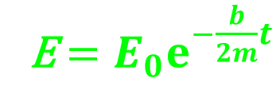
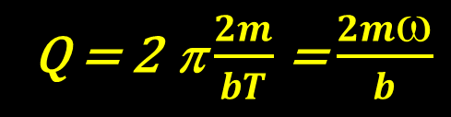
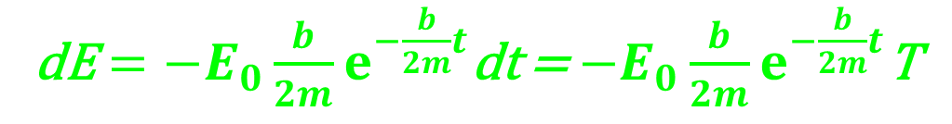
Quality factor (Q)
The quality factor measures the quality of the oscillator; less the losses (due to damping), more the quality. It is also called the figure of merit and is defined as:
2π the energy stored in the damped harmonic oscillator to the energy loss per cycle.
energy stored
Q = 2π(E /-dE) = 2π
energy loss per cycle
E$=E_{0}ⅇ^{−\frac{b}{2m}t}$
dE$={−E}_{0}{\frac{b}{2m}ⅇ}^{−\frac{b}{2m}t}$dt = ${−E}_{0}{\frac{b}{2m}ⅇ}^{−\frac{b}{2m}t}$T
Q = 2 π $\frac{2m}{bT}$ = $\frac{2mω}{b}$

Slide 18
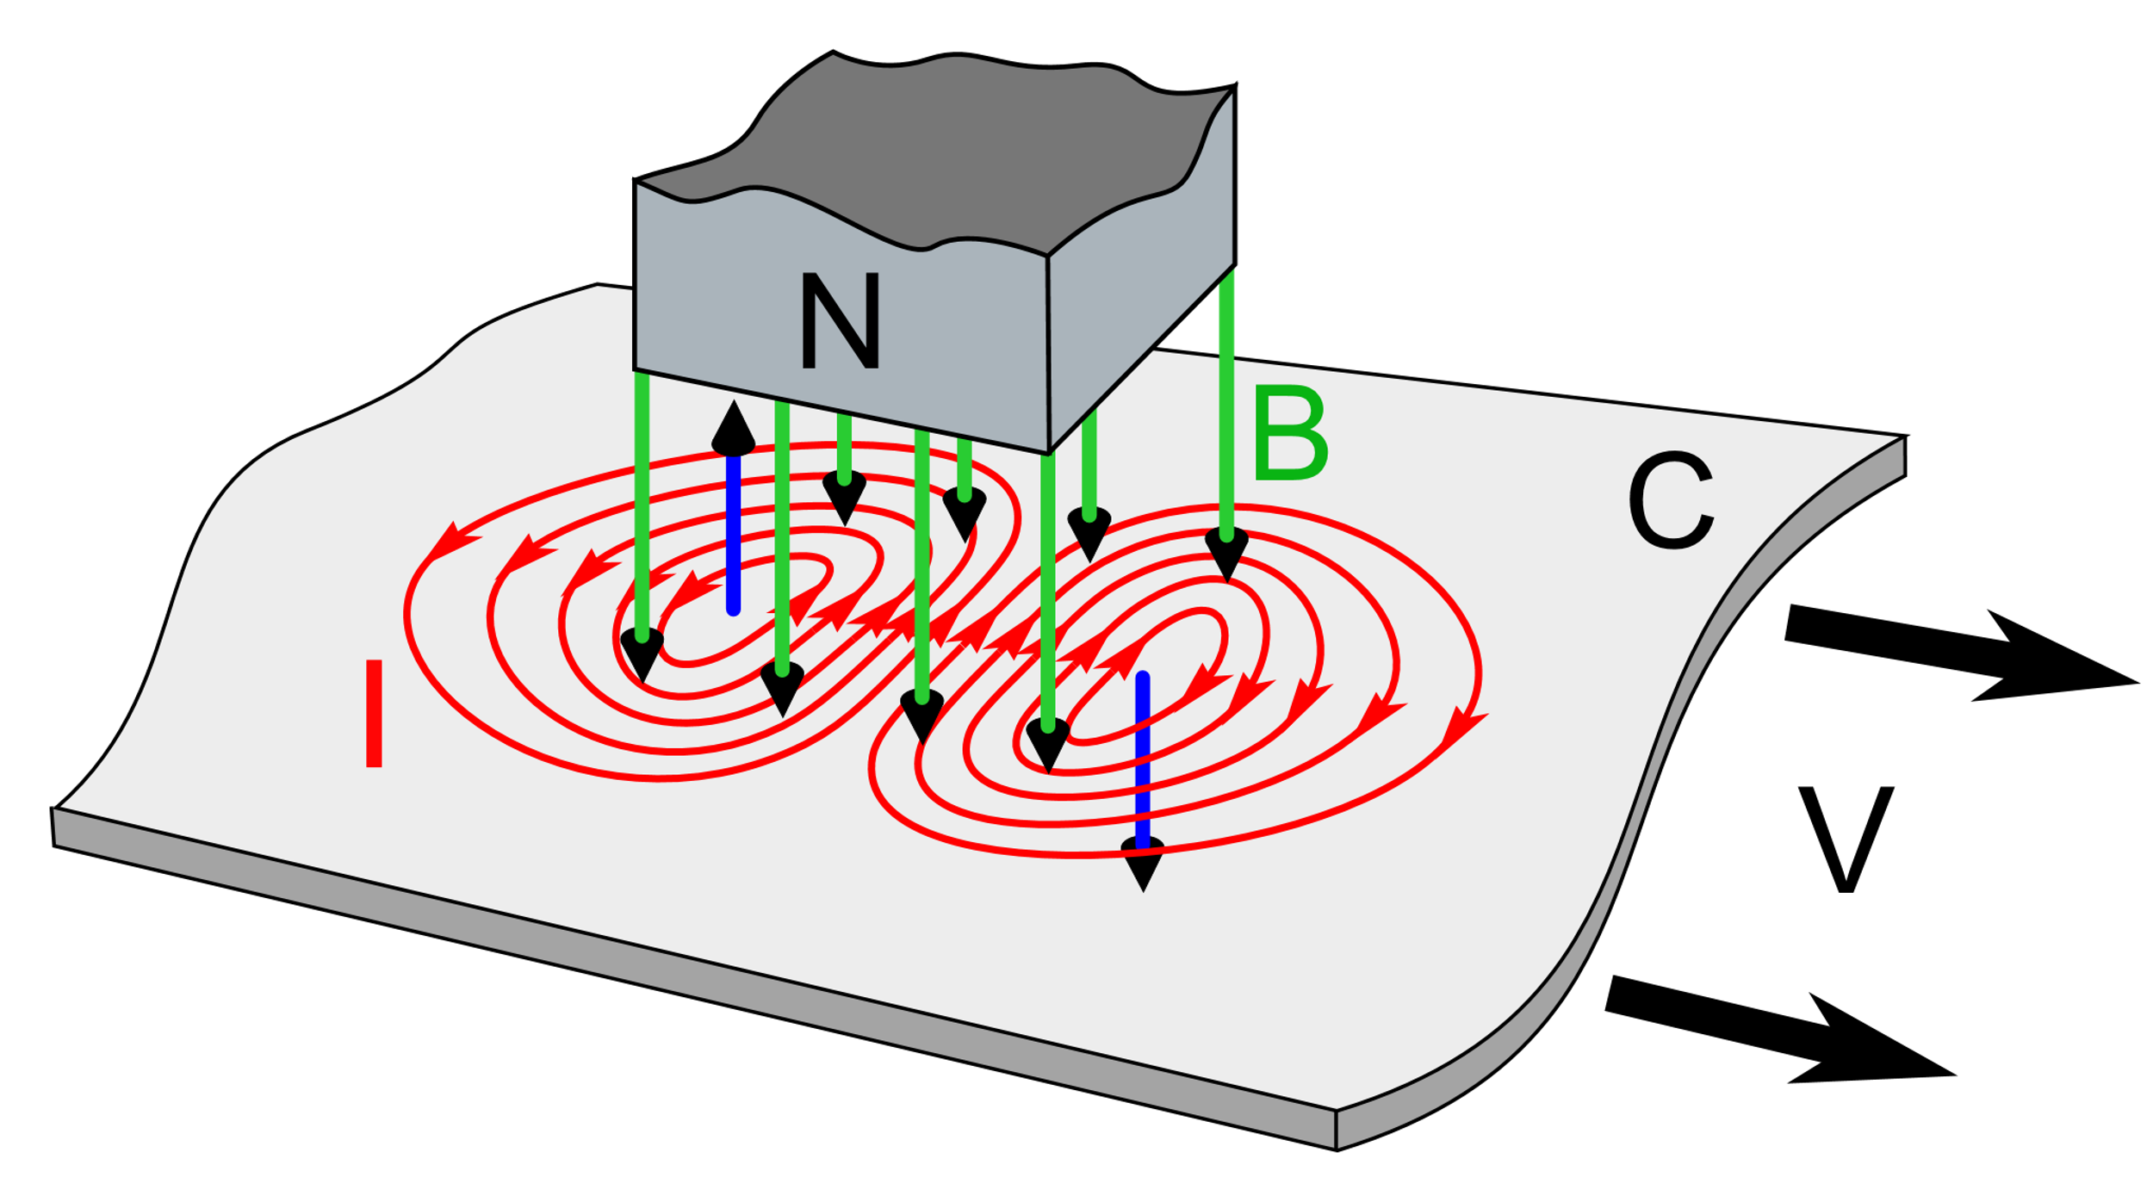
Example of damping: Eddy current
As we know that, an emf and a current are induced in a circuit by a changing magnetic flux. In the same manner, circulating currents called eddy currents are induced in bulk pieces of metal moving through a magnetic field.
V
Ref. Wikipedia

Slide 19
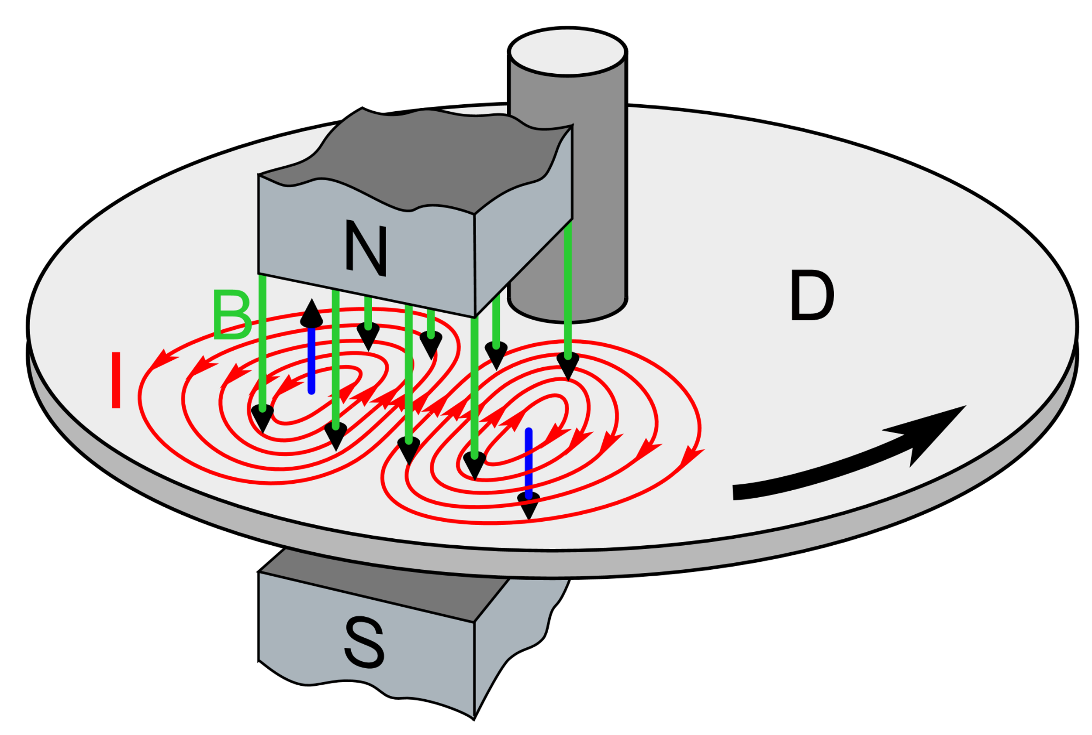
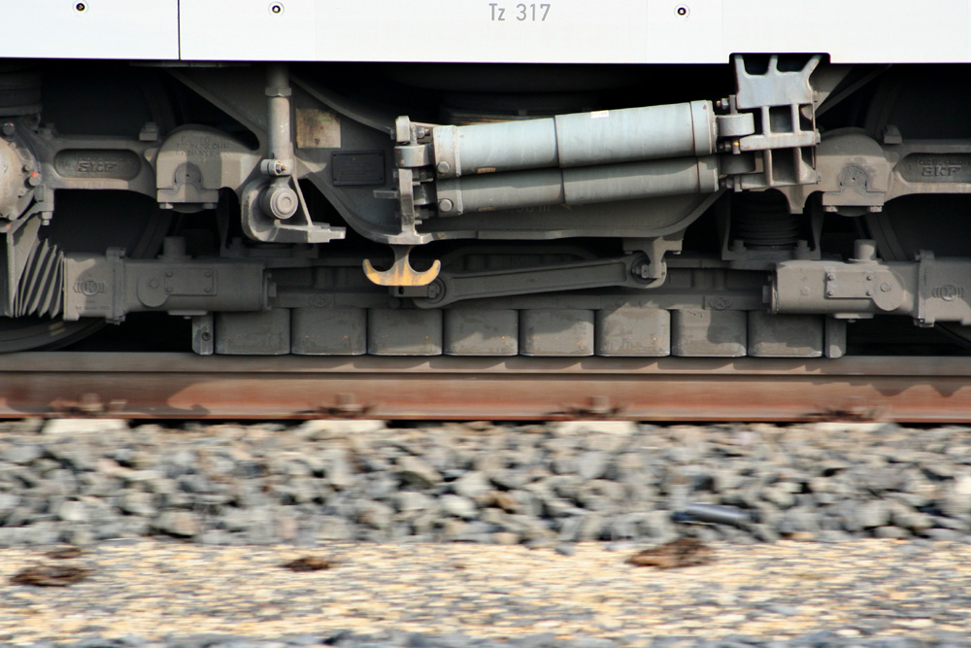
Application: Eddy current
The braking systems on many subway and rapid-transit cars make use of electro-magnetic induction and eddy currents. An electromagnet attached to the train is positioned near the steel rails. The braking action occurs when a large current is passed through the electro- magnet. The relative motion of the magnet and rails induces eddy currents in the rails, and the direction of these currents produces a drag force on the moving train. Also, as a safety measure, some power tools use eddy currents to stop rapidly spinning blades once the device is turned off.
A linear eddy current brake in a German ICE 3 high-speed train
Ref. Wikipedia

